Slide 1

Cardiology
Dr. Ed Neufeld B.A. M.Div. D.V.M.

Slide 2
Chief Complaint
Brutus is a 3 year old neutered Boxer with a history syncope.

Slide 3

Brutus

Slide 4
History
Yesterday Brutus fainted (syncope)
He seemed to recover in a few minutes
Now he seems quite normal

Slide 5
Physical Examination
Heart Rate 160 bpm
No cardiac murmur
No pulmonary congestion detected

Slide 6
Problem List
Syncope
Increased heart rate

Slide 7
Rule Outs
List all the Possible Diagnoses
This list is your Rule Out list

Slide 8
Rule Outs
DCM – Dilated Cardiomyopathy
Mitral valve endocardiosis
Pericardial Effusion,
HCM – Hypertrophic Cardiomegaly
Heartworm
Boxer cardiomyopathy

Slide 9
Eliminating Rule Outs
Which diagnoses are unlikely from
Clinical Signs
History

Slide 10
Rule Outs Based on HX/PE
DCM – likely because usually in large dogs
MR –unlikely usually small dogs with murmurs
Pericardial Effusion –unlikely can hear the heart
HCM – unlikely because usually in cats
Boxer cardiomyopathy – likely because of the breed and increased heart rate.

Slide 11
The Plan
What is your PLAN ?

Slide 12
Plan
Thoracic Radiograph
ECG
Echocardiogram

Slide 13
Radiographs
Left Lateral View
Dorsal Ventral View

Slide 14
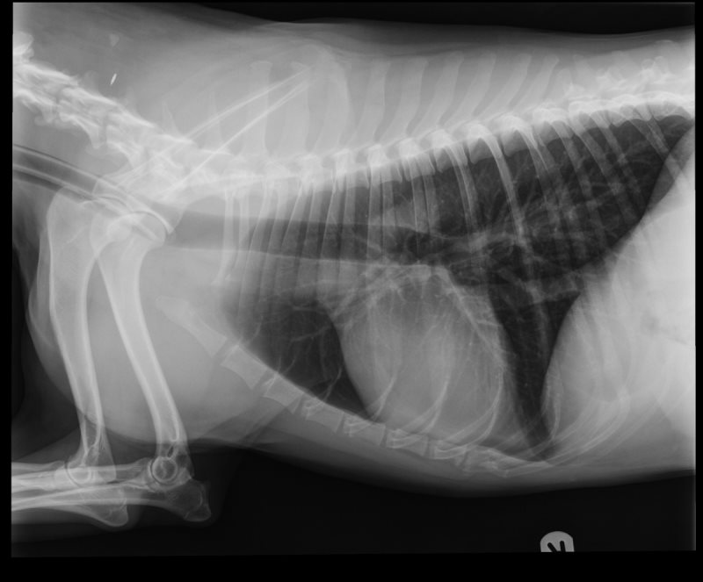
Left Lateral Thorax

Slide 15
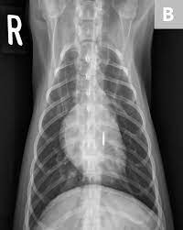
Ventral Dorsal Thorax

Slide 16
Radiograph Evaluation
List all the abnormal radiographic signs that you see on the previous radiographs

Slide 17
Radiographic Signs
No visible lesions
The radiographs are normal

Slide 18
CBC/Chemistry/Urinalysis
All parameters are within normal range

Slide 19

Normal ECG

Slide 20
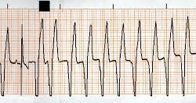
ECG - our dog

Slide 21
Ventricular Tachycardia

Slide 22
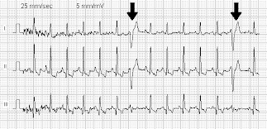
ECG with VPC’s – VPC’s not always present

Slide 23

VPC

Slide 24
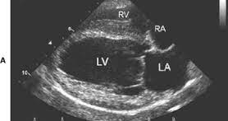
Echocardiogram

Slide 25
Echocardiogram – Normal

Slide 26
New Problem List?

Slide 27
Problem List
Ventricular Tachycardia
Ventricular Premature Complex's (VPC) .
VPC’s (not always present. Recommend using a Holter 24 hour monitoring)

Slide 28
What is your Diagnosis?
What is your diagnosis ?
What is the etiology?

Slide 29
Final Diagnosis
  Boxer Cardiomyopathy
  Genetic basis suspected

Slide 30
Treatment Plan
Treat Ventricular Tachycardia
Use: Beta Blocker to slow the heart
Sotalol (beta blocker)

Slide 31
Prognosis
Guarded
Owners should be advised that dogs are always at risk of sudden death.
Poor prognosis: if Congestive Heart Failure developes with ventricular dilatation.

Slide 32
        The End
Notes:
We will address the issues we experienced in formulating card sort statements and conducting the card sort interviews. For each of the issues identified we developed specific strategies.

Slide 33
Notes:
We will address the issues we experienced in formulating card sort statements and conducting the card sort interviews. For each of the issues identified we developed specific strategies.

Slide 34
Notes:
We will address the issues we experienced in formulating card sort statements and conducting the card sort interviews. For each of the issues identified we developed specific strategies.

Slide 35
Notes:
We will address the issues we experienced in formulating card sort statements and conducting the card sort interviews. For each of the issues identified we developed specific strategies.

Slide 36
Notes:
We will address the issues we experienced in formulating card sort statements and conducting the card sort interviews. For each of the issues identified we developed specific strategies.

Slide 37
Notes:
We will address the issues we experienced in formulating card sort statements and conducting the card sort interviews. For each of the issues identified we developed specific strategies.

Slide 38
Notes:
We will address the issues we experienced in formulating card sort statements and conducting the card sort interviews. For each of the issues identified we developed specific strategies.

Slide 39
Notes:
We will address the issues we experienced in formulating card sort statements and conducting the card sort interviews. For each of the issues identified we developed specific strategies.

Slide 40
Notes:
We will address the issues we experienced in formulating card sort statements and conducting the card sort interviews. For each of the issues identified we developed specific strategies.

Slide 41
Notes:
We will address the issues we experienced in formulating card sort statements and conducting the card sort interviews. For each of the issues identified we developed specific strategies.

Slide 42
Notes:
We will address the issues we experienced in formulating card sort statements and conducting the card sort interviews. For each of the issues identified we developed specific strategies.

Slide 43
Notes:
We will address the issues we experienced in formulating card sort statements and conducting the card sort interviews. For each of the issues identified we developed specific strategies.

Slide 44
Notes:
We will address the issues we experienced in formulating card sort statements and conducting the card sort interviews. For each of the issues identified we developed specific strategies.

Slide 45
Notes:
We will address the issues we experienced in formulating card sort statements and conducting the card sort interviews. For each of the issues identified we developed specific strategies.

Slide 46
Notes:
We will address the issues we experienced in formulating card sort statements and conducting the card sort interviews. For each of the issues identified we developed specific strategies.

Slide 47
Notes:
We will address the issues we experienced in formulating card sort statements and conducting the card sort interviews. For each of the issues identified we developed specific strategies.

Slide 48
Notes:
We will address the issues we experienced in formulating card sort statements and conducting the card sort interviews. For each of the issues identified we developed specific strategies.

Slide 49
Notes:
We will address the issues we experienced in formulating card sort statements and conducting the card sort interviews. For each of the issues identified we developed specific strategies.

Slide 50
Notes:
We will address the issues we experienced in formulating card sort statements and conducting the card sort interviews. For each of the issues identified we developed specific strategies.

Slide 51
Notes:
We will address the issues we experienced in formulating card sort statements and conducting the card sort interviews. For each of the issues identified we developed specific strategies.

Slide 52
Notes:
We will address the issues we experienced in formulating card sort statements and conducting the card sort interviews. For each of the issues identified we developed specific strategies.

Slide 53
Notes:
We will address the issues we experienced in formulating card sort statements and conducting the card sort interviews. For each of the issues identified we developed specific strategies.

Slide 54
Notes:
We will address the issues we experienced in formulating card sort statements and conducting the card sort interviews. For each of the issues identified we developed specific strategies.

Slide 55
Notes:
We will address the issues we experienced in formulating card sort statements and conducting the card sort interviews. For each of the issues identified we developed specific strategies.

Slide 56
Notes:
We will address the issues we experienced in formulating card sort statements and conducting the card sort interviews. For each of the issues identified we developed specific strategies.

Slide 57
Notes:
We will address the issues we experienced in formulating card sort statements and conducting the card sort interviews. For each of the issues identified we developed specific strategies.

Slide 58
Notes:
We will address the issues we experienced in formulating card sort statements and conducting the card sort interviews. For each of the issues identified we developed specific strategies.

Slide 59
Notes:
Some researchers describe card or pile sorts as “invention activity” [Nastasi & Berg (1999) in their discussion of ethnography and intervention programs refer to pile sorts in program implementation as “intervention activity to promote understanding of individual and collective meaning of key constructs” (p. 9).]
At the end of each interview, women were given the opportunity to reflect on their experience of doing the card sort activities. Many women expressed how good it was to realize that they were not alone in their caregiving struggles. “I’m not the only one feeling this way.”
These women were in the midst of heavy caregiving work and acknowledged that they rarely sits had the time to think about their caregiving because they had “to keep carrying on.” CSA-14
Women also valued the opportunity to help other caregivers through their participation in research and reassured the researchers repeatedly that although their time was limited due to their caregiving they were willing to be further involved in this research because they hoped that it would make a difference for other caregivers.

Slide 60
Notes:
Some researchers describe card or pile sorts as “invention activity” [Nastasi & Berg (1999) in their discussion of ethnography and intervention programs refer to pile sorts in program implementation as “intervention activity to promote understanding of individual and collective meaning of key constructs” (p. 9).]
At the end of each interview, women were given the opportunity to reflect on their experience of doing the card sort activities. Many women expressed how good it was to realize that they were not alone in their caregiving struggles. “I’m not the only one feeling this way.”
These women were in the midst of heavy caregiving work and acknowledged that they rarely sits had the time to think about their caregiving because they had “to keep carrying on.” CSA-14
Women also valued the opportunity to help other caregivers through their participation in research and reassured the researchers repeatedly that although their time was limited due to their caregiving they were willing to be further involved in this research because they hoped that it would make a difference for other caregivers.

Slide 61
Notes:
Some researchers describe card or pile sorts as “invention activity” [Nastasi & Berg (1999) in their discussion of ethnography and intervention programs refer to pile sorts in program implementation as “intervention activity to promote understanding of individual and collective meaning of key constructs” (p. 9).]
At the end of each interview, women were given the opportunity to reflect on their experience of doing the card sort activities. Many women expressed how good it was to realize that they were not alone in their caregiving struggles. “I’m not the only one feeling this way.”
These women were in the midst of heavy caregiving work and acknowledged that they rarely sits had the time to think about their caregiving because they had “to keep carrying on.” CSA-14
Women also valued the opportunity to help other caregivers through their participation in research and reassured the researchers repeatedly that although their time was limited due to their caregiving they were willing to be further involved in this research because they hoped that it would make a difference for other caregivers.

Slide 62
Notes:
Some researchers describe card or pile sorts as “invention activity” [Nastasi & Berg (1999) in their discussion of ethnography and intervention programs refer to pile sorts in program implementation as “intervention activity to promote understanding of individual and collective meaning of key constructs” (p. 9).]
At the end of each interview, women were given the opportunity to reflect on their experience of doing the card sort activities. Many women expressed how good it was to realize that they were not alone in their caregiving struggles. “I’m not the only one feeling this way.”
These women were in the midst of heavy caregiving work and acknowledged that they rarely sits had the time to think about their caregiving because they had “to keep carrying on.” CSA-14
Women also valued the opportunity to help other caregivers through their participation in research and reassured the researchers repeatedly that although their time was limited due to their caregiving they were willing to be further involved in this research because they hoped that it would make a difference for other caregivers.

Slide 63
Notes:
Some researchers describe card or pile sorts as “invention activity” [Nastasi & Berg (1999) in their discussion of ethnography and intervention programs refer to pile sorts in program implementation as “intervention activity to promote understanding of individual and collective meaning of key constructs” (p. 9).]
At the end of each interview, women were given the opportunity to reflect on their experience of doing the card sort activities. Many women expressed how good it was to realize that they were not alone in their caregiving struggles. “I’m not the only one feeling this way.”
These women were in the midst of heavy caregiving work and acknowledged that they rarely sits had the time to think about their caregiving because they had “to keep carrying on.” CSA-14
Women also valued the opportunity to help other caregivers through their participation in research and reassured the researchers repeatedly that although their time was limited due to their caregiving they were willing to be further involved in this research because they hoped that it would make a difference for other caregivers.

